Slide 1


The Road to eClose Adoption

Slide 2

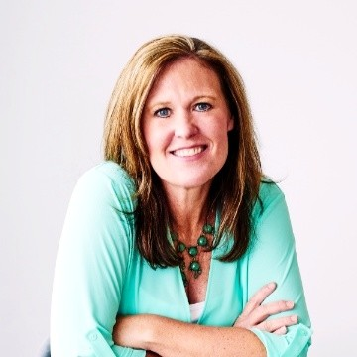

Jeff Henkel
SVP of Closing Fulfillment
Julia Peavy
Senior Implementation Manager

Slide 3

Today’s Agenda
What is an eClosing?
The current State of Adoption
Lender Perspective - Taylor Morrison
Where is the Industry headed?
Questions and Resources

Slide 4


Closing Types
-
+
Improve borrower experience + Handle more loans + Improve process efficiencies
Wet
Hybrid
Full eClose
eSigning
/
eNote
eNotarization
/
eRecording
/

Slide 5
State of eClose Adoption
eNotes Registrations Per Year
592,596
462,671
127,358
8,307
5,220
16,950
2,372
2015
2016
2017
2018
2019
2020
2021
Source: MERSCORP Holdings, Inc.

Slide 6

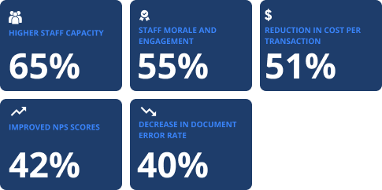
State of eClose Adoption
Lender Benefits

Slide 7
Meet the Lender
Meet the Lender
Digital Closing Results
94%
80%
100%
borrowers previewed their documents prior to the closing
loan closings eligible to eSign
closings on platform

Slide 8
Q&A
To learn more our State of Adoption Research, visit: https://www.snapdocs.com/resource-center/infographic-state-of-digital-mortgage-closing-adoption
To learn more Taylor Morrison’s eClosing journey, visit: https://www.snapdocs.com/resource-center/customer-stories-taylor-morrison

