Slide 1

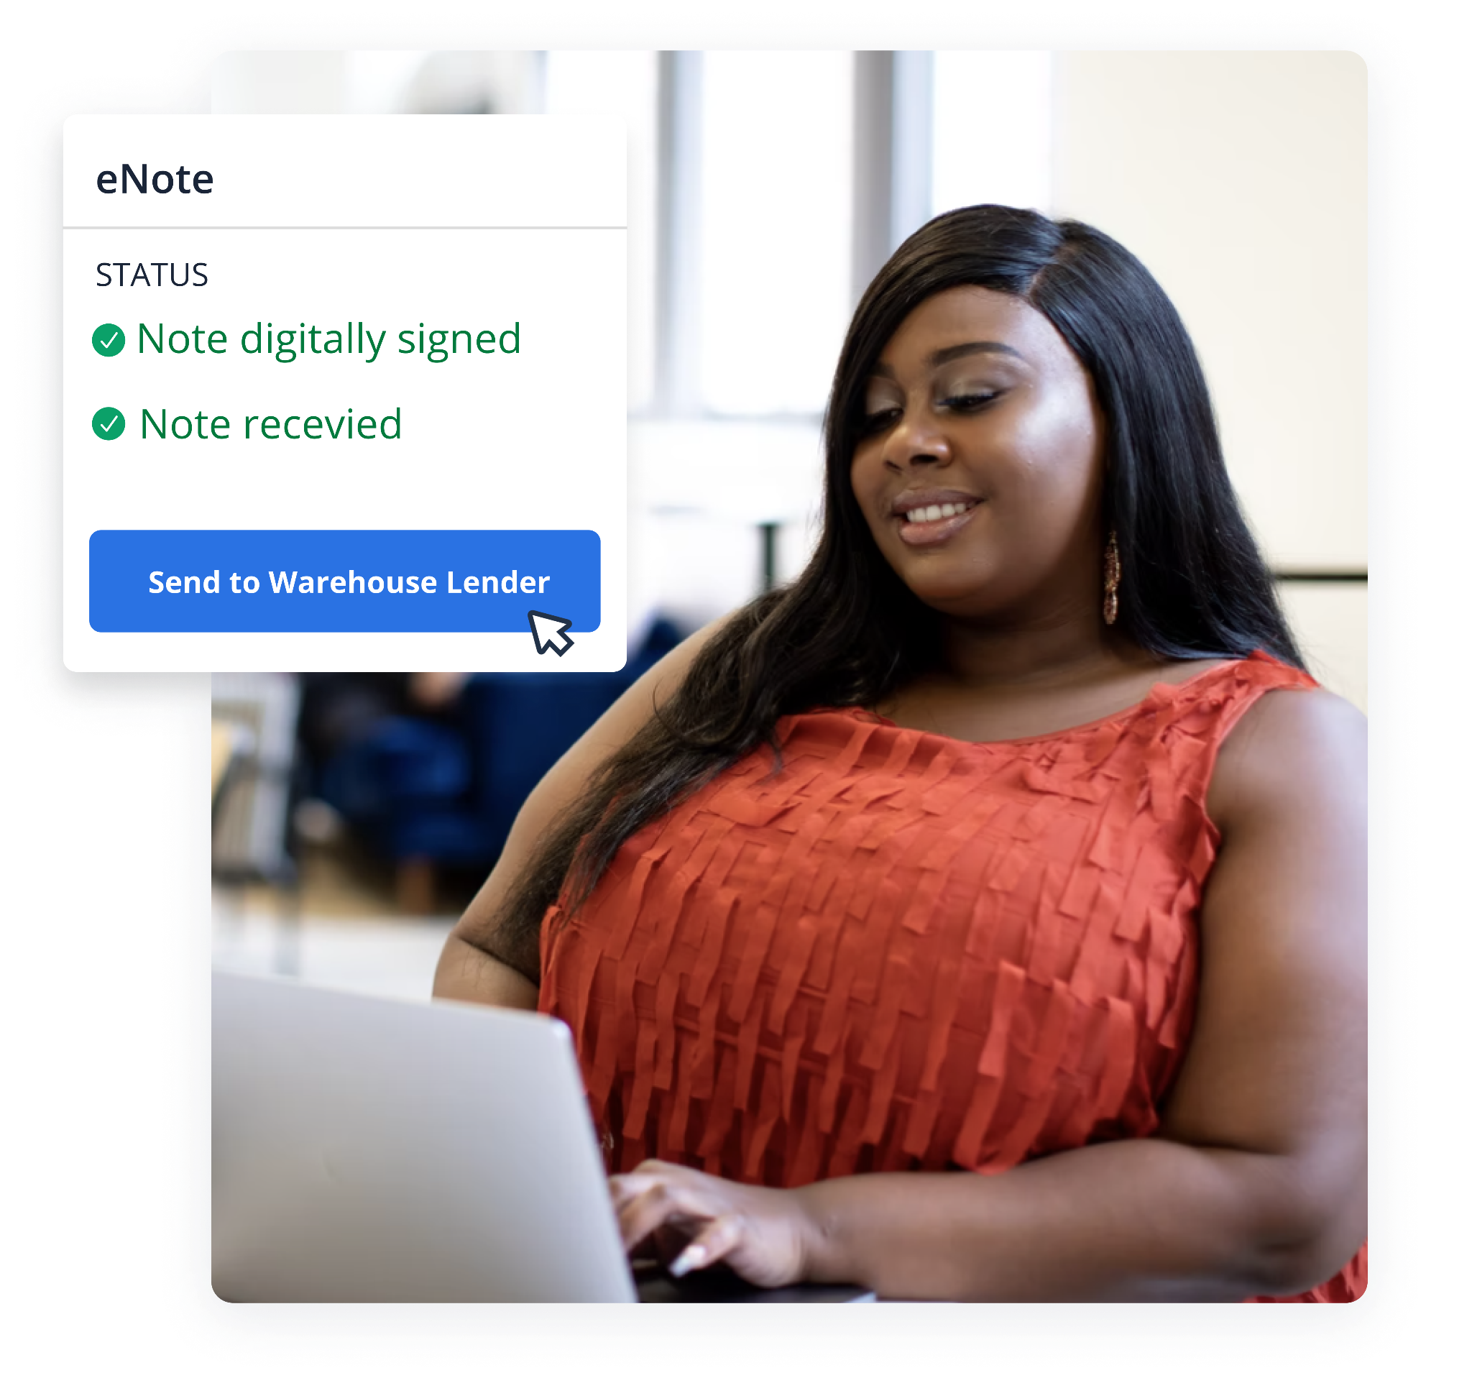

Solve the Puzzle
of e-Eligibility
TMConnect Webinar

Slide 2






Akash Bose
Director, Market Intelligence
Rebecca Perkovich
Manager, Digital Mortgage
Femi Ayi
VP Branching Operations

Slide 3
Key Session Takeaways
Why lenders are focused on streamlining their understandings of e-Eligibility
What factors influence the e-Eligibility for a lender
How lenders apply e-Eligibility
01
02
03

Slide 4

Closings are complicated due to fragmentation
The perfect closing requires connecting all parties to make each experience transparent, fast, error-free, and secure
Digitized with Snapdocs today
Future-state digitization
Abstracting
Recording
Warehouse lender
Appraisals
eVault
Closing
Borrower
Real Estate Agent
Broker
Lender
Pre-Closing
Post-Closing
Investor
Escrow
Notary
QC
Servicing
Signing Service
Title
Securitization

Slide 5

250k+
closings / mo
Snapdocs
is the market leader
in closings
240+
Lenders
50k+
Settlement Offices
140k+
Notaries
50%+
MERS eNote onboardings in H2 2020

Slide 6

e-Eligibility Assessment
Snapdocs and Falcon Capital Advisors have partnered to produce the e-Eligibility assessment
The e-Eligibility assessment provides:
A breakdown of an organization’s entire loan portfolio that allows lenders to determine how digitized each loan can be
A roadmap and business case for scaling a digital closing strategy
Expert recommendations on how to implement digital closings to all loan types, including wet, hybrid and full eClose

Slide 7
e-Eligibility 101
1
eMortgage
e-Eligibility refers to the extent to which a mortgage closing can be digitized
There are five primary factors that enable, restrict, and otherwise impact the extent to which a loan can be closed digitally
2
Types of eClosings
3
Primary forms of eNotarization
4
MERS® eRegistry
5
eNote

Slide 8





The 5 Factors of e-Eligibility
Counterparty
Requirements
Title Underwriter Restrictions
County Registrations
Settlement Readiness
eNotarization
Regulations

Slide 9

R1
R1: Counterparty Requirements
Results
Results
8 out of the 17 top investors accept eSigned & eNotarized security instruments
What are counterparties?
39%
of loan vol.
8 out of the 17 top investors accept eNotes
39%
of loan vol.
Counterparties include investors to who Revolution Mortgage sells loans, as well as any warehouse lenders used to fund originated loans. Counterparties may also include services, subservicers, and custodians.
7 investors in our list of 17 accept RON
8 investors in our list of 17 accept IPEN
What did we evaluate in this assessment?
38%
of loan vol.
39%
of loan vol.
We examined eMortgage and eNotarization policies of any investor that purchased at least 1% of Revolution Mortgage’s loans.

Slide 10
R1
R2
R3
R2-3: County Registrations + eNotarization Regulations
Additional details for Revolution’s top 5 states by origination volume
Noteworthy callout: Of the top 10 counties where Revolution had the highest origination activity, 5 were in Ohio (a high-potential state). All 10 counties, even the ones in medium and low potential states, allow eRecording.
Key Takeaways
Top 5 states by Revolution’s origination
activity
5
states represent 50%+ Revolution’s origination activity over the T12M
100%
Of these were flagged as high potential
100%
Of top 10 counties allow eRecording. 62% of all US counties offer it.
Out of the states we analyzed:
20 states were flagged as high-potential
13 flagged were identified as medium potential
17 were flagged as low potential
All of the top 5 states by origination vol. were identified as high potential for full eClose.
Why do full eClose? Doing so leads to value gain in terms reduced cost (improved margins), improved borrower experience, and accelerated gain on sale

Slide 11
R1
R2
R3
Results
R2-3: County Registrations, eNotarization Regulations
Results
Can we record eMortgage transactions?
The availability of electronic recording (“eRecording”) and eNotarization are significant drivers in the determination of how “e” Revolution Mortgage can be. In a full eClosing, the security instrument would be eSigned and eNotarized. Recording eSigned and eNotarized security instruments with a county recorder’s office requires:
eRecording: The county provides eRecording as an option to borrowers OR
Paper-out: The state in which the county is located has a law permitting a printed copy of the electronic record to be submitted for recording (often referred to as “paper-out” recording).
Top 5 states by Revolution’s origination
activity
High potential: State permits IPEN, RON, and paper-out recording
Medium Potential: State permits IPEN and RON, not paper-out recording. However, at least 60% of recording jurisdictions in the state offer eRecording
Low Potential: The state does not meet the criteria for either High or Medium potential for full eClosings
What did we evaluate in this assessment?
We analyzed all states where Revolution indicated origination activity. Our assessment segments each state into one of 3 categories by their potential for full eClose.

Slide 12
How Lenders Apply e-Eligibility
1
Optimize eClosing Implementation
Apply these factors to determine which closing types are achievable as you begin implementation.
2
Maximize eClosing Utilization
Already support some degree of digital mortgage closings? Manage e-Eligibility at the
transaction level to increase the digitization of each closing.
3
Manage Compliance Risk and Liquidity
By addressing e-Eligibility factors well before closing, lenders can mitigate compliance risk and protect your loan liquidity.
4
Gain First-mover Advantage
With a framework for e-Eligibility, you’ll be ready to incrementally expand your digital mortgage closing programs over time.

Slide 13
Key Session Takeaways
1
Why lenders are focused on streamlining their understandings of e-Eligibility
Increasing industry adoption
Operational efficiency
Improved borrower experience
2
What factors influence the e-Eligibility for a lender
Counterparty requirements
Title underwriter restrictions
County registrations
Settlement readiness
eNotarize regulations
3
How lenders apply e-Eligibility
Optimizing eClosing implementation
Maximize eClosing utilization
Manage compliance risk and liquidity
Gain first-mover advantage

Slide 14
What’s Next?

Slide 15

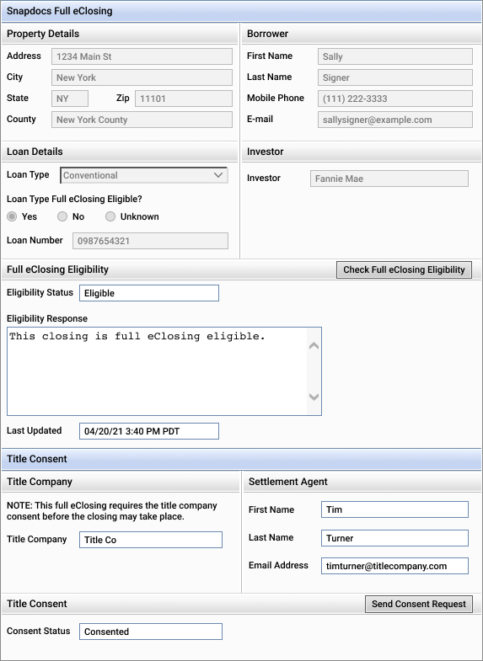
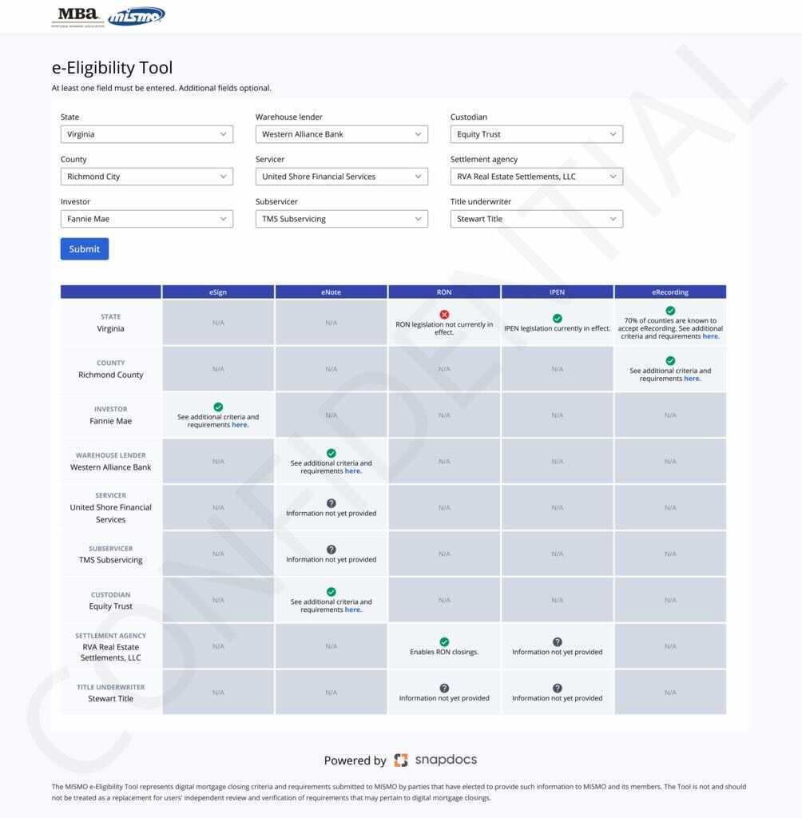
MISMO Partnership: automating e-Eligibility
Ensure the closing type selected is right the first time - every time - so you maximize eNote adoption
With Snapdocs e-Eligibility tools, you can optimize each loan to be as “e” as it can be based on investor & jurisdiction constraints
This ensures no eNote adoption is lost
e-Eligibility Exchange
Enabling the Mortgage Industry to pursue digital closings with confidence
Provides clarity and standards for digital closings to accelerate adoption.
Centralized repository of e-Eligibility criteria, regulations and readiness.
User Interface and API allowing industry professionals to determine digital closing options.
Notes:
We’re solving the coordination problem across various parties for eclosings.
The purpose of he mismo e-eligibility exchange is to inspire confidence in lenders to perform digital closings. We’ll do this by covering all digital closing variants - esignature, RON, eRecording, etc.
Industry participants and provide eligibility and requirements, and other participants can easily look it up.
Notes if questions about how many of the 250k closings/mo are eNotes:
Over 20% of our lenders are currently processing eNotes on the platform
Over 50% of those lenders are processing 5,000 loans or more per year

Slide 16



Connect with Us
Reach out to your TMC Member Advocate or your Snapdocs Account Executive to learn more about the free e-Eligibility assessment
Schedule time at TMC Days, Miami Nights conference in March

Slide 17
Q&A

Slide 18
Thank you!

