Slide 1


Creating a Better Borrower Experience with Assurance Financial

Slide 2
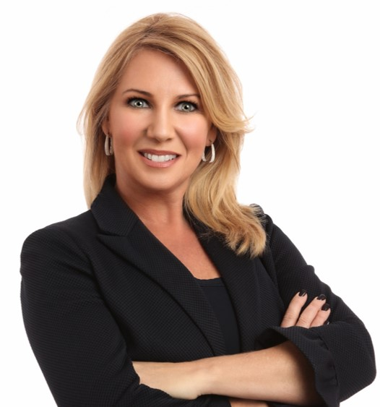



Katherine Campbell
Chief Digital Officer
Jeremy Lee
Senior Engagement Manager

Slide 3

Today’s Agenda
eClosing Accomplishments
Current Outlook
What’s Next for Assurance Financial
Questions and Resources

Slide 4
eClosing Accomplishments
Digital Closing Results
93%
8 min
4.94
hybrid closings
loan closings eligible to eSign
out of 5 stars from 16,000 reviews

Slide 5



Current Outlook
QR cover pages for borrower preview
Doc redraw for seamless borrower experience
Whitelabeling emails

Slide 6



What’s Next
Further adoption of RON & eNote
Utilizing Closing Quality Control Tool
OCR and confirmation of docs

Slide 7
Q&A

